Slide 1
Azure Functions
Developing precompiled Azure Functions for production
Presented by: Adam Vincent
Twitter: @entity_adam
GitHub: http://github.com/entityadam
Notes:
Abstract:
In this presentation I will be covering how to create precompiled Azure Functions in Visual Studio and how to configure continuous integration and deployment pipelines. I will also be covering some concepts and design patterns that are important when working with serverless functions in production. The example Azure Functions in this presentation will expand on previous talks about hosting static websites, and how to add functionality to your static site.
Presented by Adam Vincent
I am a Software Engineer at Applied Information Sciences (AIS) and relatively new to the game with 3 years of experience in C# and the .NET stack. I am an advocate for Clean Code, Humane Code and other variants of developing software that is structured not only to meet the requirements of the user, but also software that can be read and maintained because the code clearly communicates the intent of the code.

Slide 2
Overview
Overview

Slide 3
Overview
Overview
Overview

Slide 4
Overview
Overview
Overview
Overview

Slide 5
Overview
Overview
Overview
Overview
Overview

Slide 6
Overview
Overview
Overview
Overview
Overview
Overview

Slide 7
Overview
Overview
Overview
Overview
Overview
Overview
StackOverflowException

Slide 8
An error has occurred with this presentation, thanks for coming. See you next week.

Slide 9
Azure Functions
Developing precompiled Azure Functions for production

Slide 10
Overview
Overview
Get Ready
File -> New Project
Source Control
Get Set
Configuration
CI/CD (PaaS)
Code!
The problem
The implementation
Questions
Notes:
Get Ready
I’m going to quickly walk through starting at File -> New Project. I’m not going in depth because you can go back and review the slides later if you want. They key points are going to be the multitude of options available for implementing Azure Functions.
Get Set
Again a set of slides you can review later, and again the take away are the options for configuring and setting up continuous integration and deployment
Code!
Once we set up our new project, source control and CI/CD pipeline, we’ll begin iterating over the development cycle to include code -> configure -> deploy

Slide 11
Get Ready - Options
Source Control Options – GitHub | Azure Devops | BitBucket | OneDrive | Dropbox | Local Git + More

Slide 12
Get Ready
File -> New Project
Create new Functions App
Source Control
Add project to source control
Push code to a repository

Slide 13
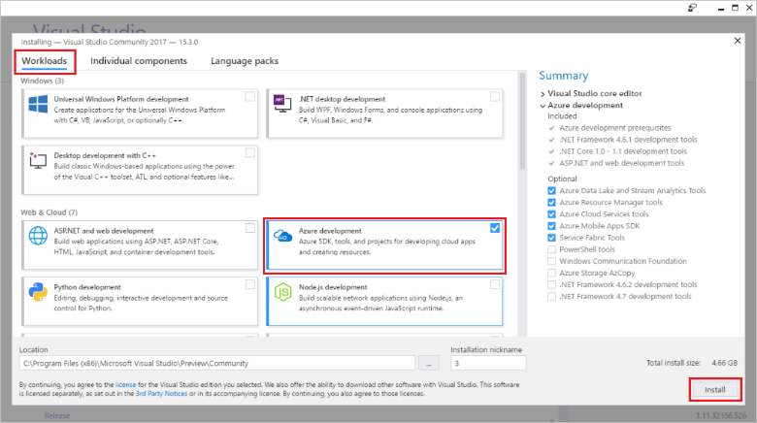
Get Ready

Slide 14
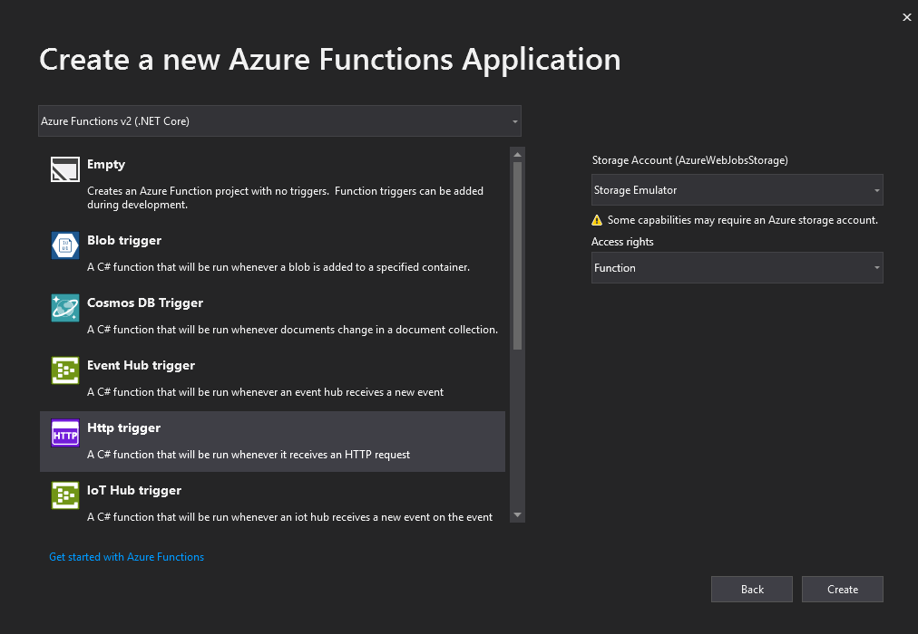
Get Ready

Slide 15
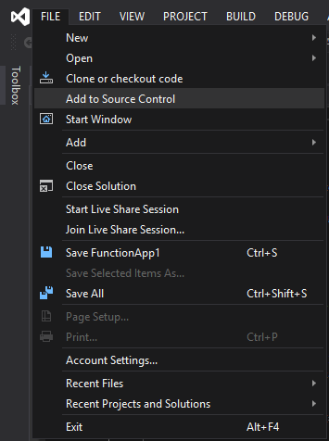
Get Ready

Slide 16
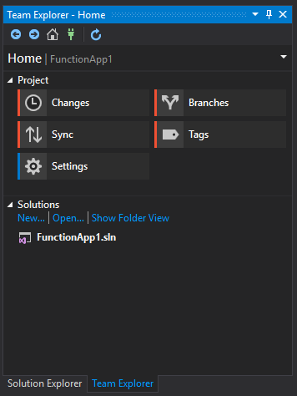
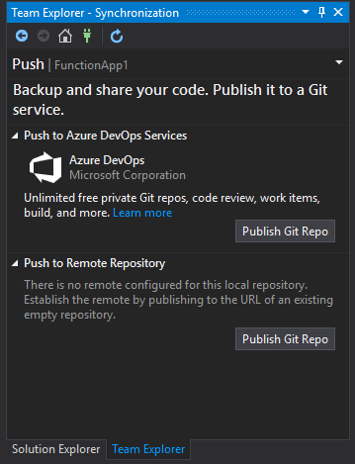
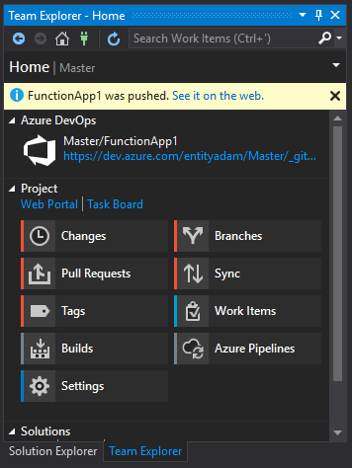
Get Ready

Slide 17
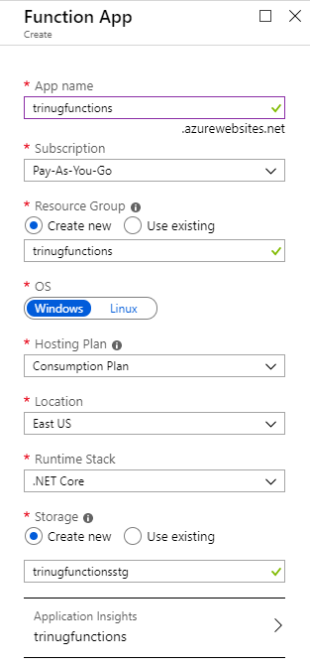
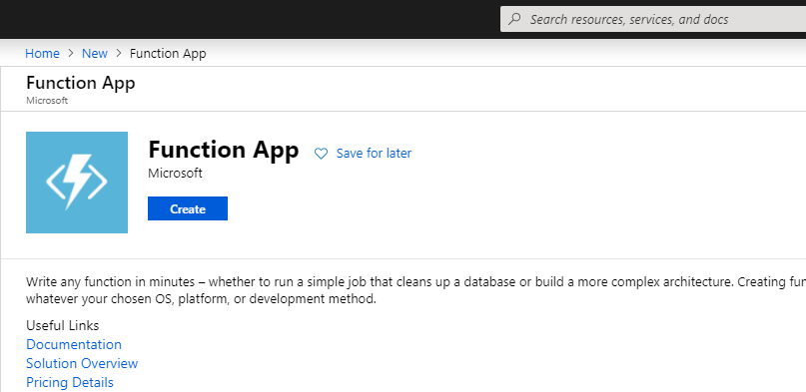
Get Ready – Functions App

Slide 18
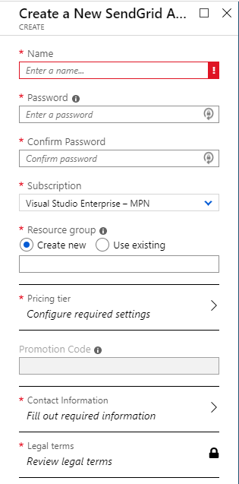
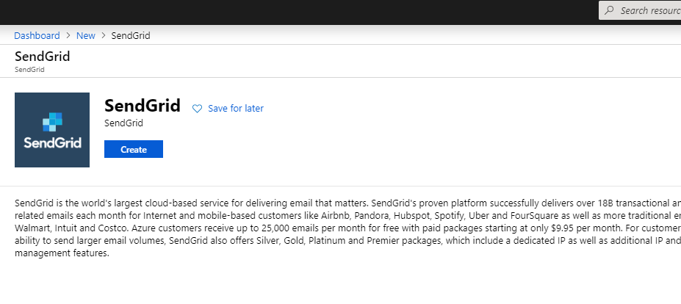
Get Ready - SendGrid Account

Slide 19
Get Set
Configuration
Minimum configuration included with File -> New Project
Deployment
Create build pipeline
Create release pipeline

Slide 20
Get Set - Options
Configuration – PaaS | IaaS
Deployment – Publish | Functions App Deployment Center (PaaS) | DevOps Pipeline Classic (PaaS) | DevOps Pipeline YAML (IaaS)

Slide 21
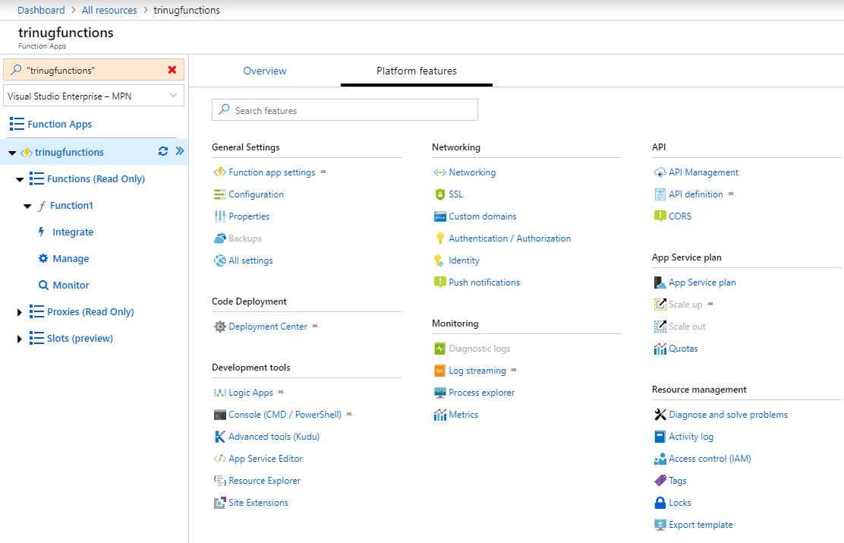
Get Set

Slide 22
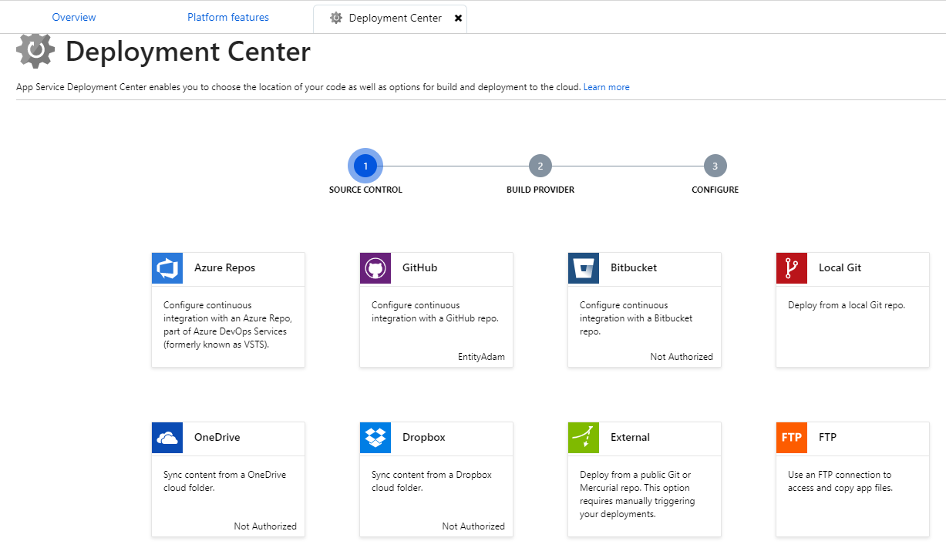
Get Set

Slide 23
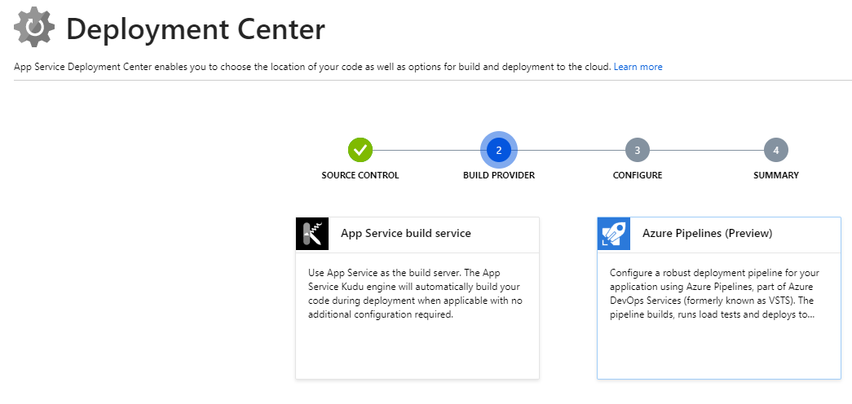
Get Set

Slide 24
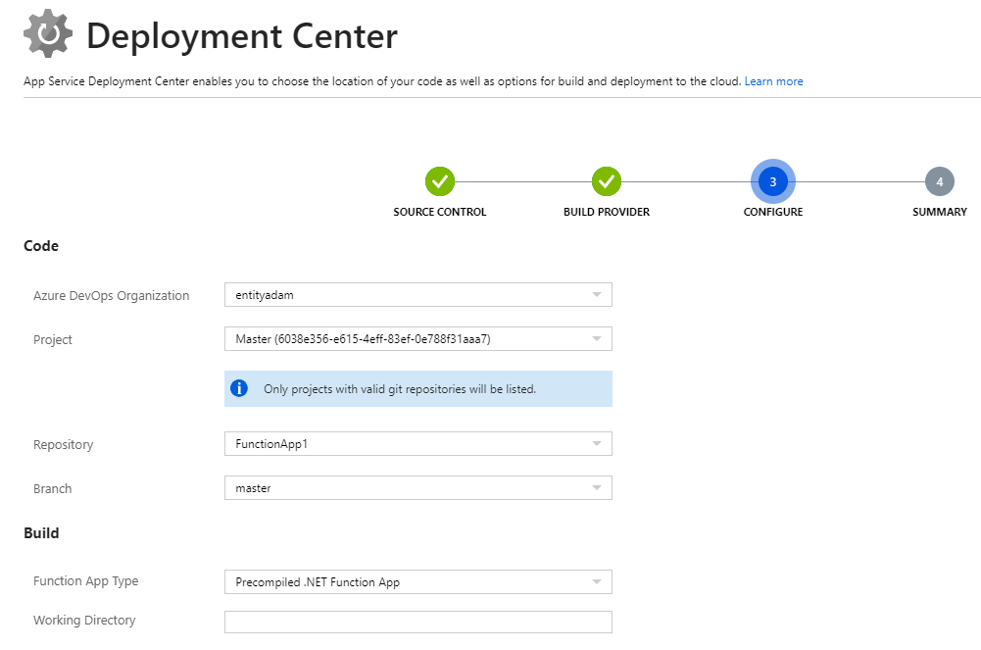
Get Set

Slide 25
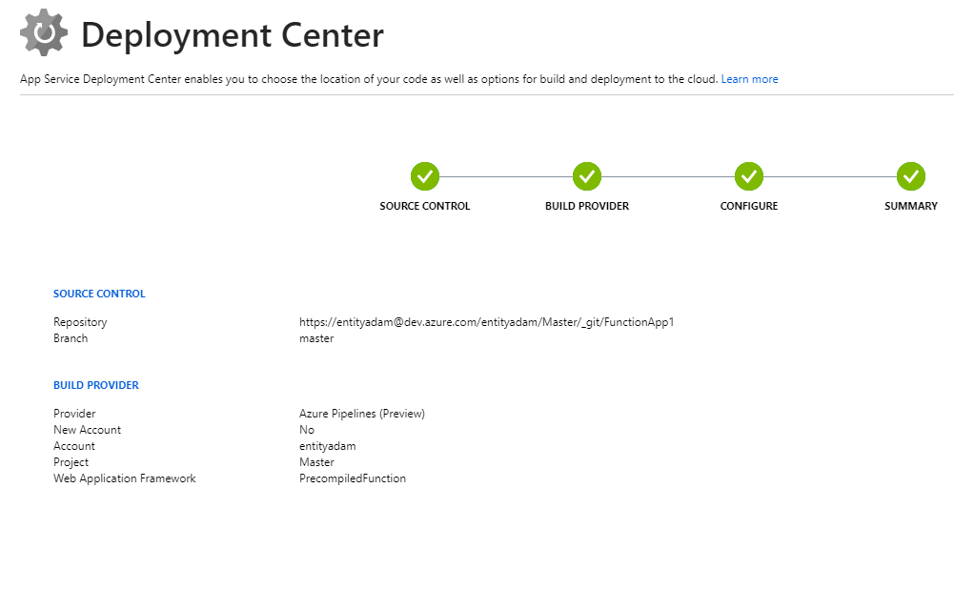
Get Set

Slide 26
Code!
Azure Functions for production

Slide 27
The Problem - User Stories
As a user of website X, I want to be able to fill out a basic form to provide my name, email address or phone number and a short message that will reach a representative to negotiate business.
As a owner of website X, I want my users to have a mechanism on my website to contact me.
As a spammer, I want to spam spam spam spam spam spam spam eggs sausage and spam.
As an owner of website X, I want to reduce the amount of spam that reaches my inbox. Even at the expense of UX.

Slide 28
The Problem – Decision Constraints
Website X is a static site served from Azure Storage
A static website is only capable of client side validation

Slide 29
Concepts
Validation
Client side data validation
Server side data validation
Content validation
Serverless doesn’t mean serverless

Slide 30
Validation Flow
Client Side Validation
Server Side Validation
Content Validation
User Input
Form Data
Form Data
Form Data
Sales representative
Form Data
No Action
Unique ID
Unique ID
Validation Errors
Delete data after X hours
User Action
Validation Errors

Slide 31
User Input
JS Client Side Validation
User Input
Azure Functions Endpoint
Form Data
HTTP Post
Validation Errors

Slide 32
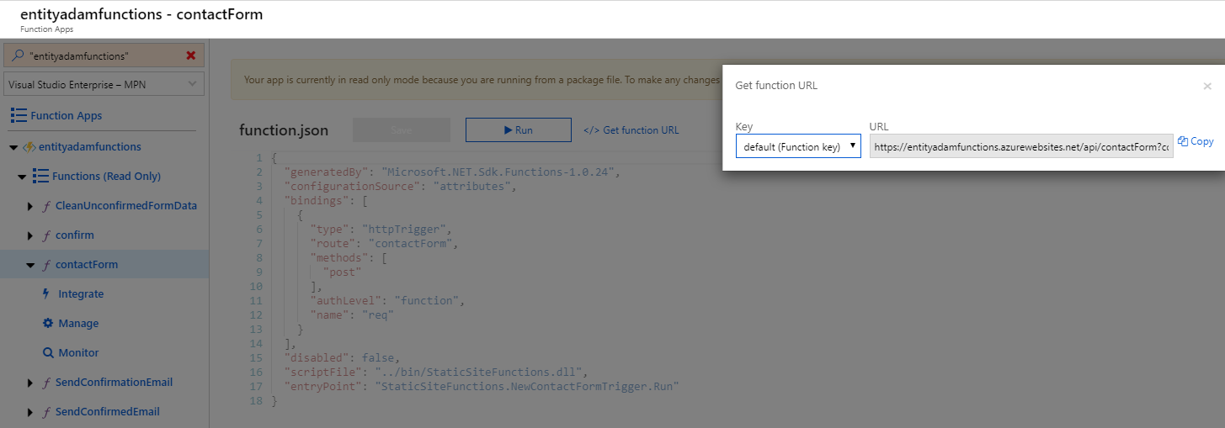
Client Side Validation

Slide 33
Azure Functions Endpoint
<schema>:<resource>.azurewebsites.net/api/<endpoint>?code=<functionsKey>
Schema – HTTPS
Subdomain – Unique Resource Name (ex: trinugfunctions)
Domain – azurewebsites.net
Default Route – /api/<endpoint>
Endpoint – Function Name
Functions Key – Authorization Key

Slide 34
/api/contactForm – Data Flow
AJAX
Form Data
HTTP Trigger
Form Data
Validate
Form Data
Queue
unconfirmed-formdata
HTTP Response - Validation Errors

Slide 35
/api/contactForm – Code
Woo! The good stuff
Cue Visual Studio.

Slide 36
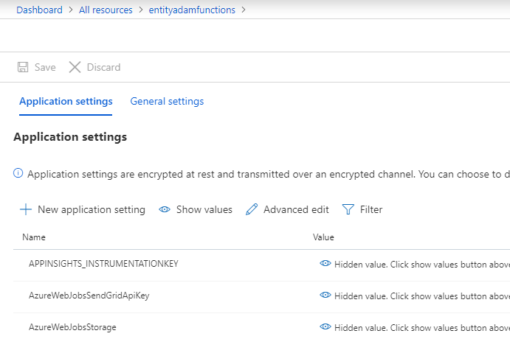
/api/contactForm – Configuration
Local configuration
!Don’t check this in!
local.settings.json
Deployment configuration

Slide 37
QueueTrigger – unconfirmed-formdata
Queue
unconfirmed-formdata
Form Data
Queue Trigger
Form Data
Send Confirm Link
Form Data
Table
AwaitConfirmationFormData
SendGrid Email
To User
Unique ID

Slide 38
QueueTrigger – unconfirmed-formdata – Code
Woo! The good stuff
Cue Visual Studio.

Slide 39
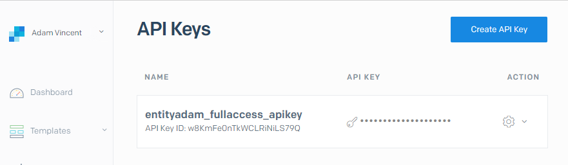
QueueTrigger – unconfirmed-formdata – Configuration
Local configuration
local.settings.json (don’t check this in!)
Deployment configuration
SendGrid configuration
API Key Id
API Key
Sender Auth (out of scope)

Slide 40
api/confirm – Control Flow
User clicks link in email from SendGrid
HTTP Trigger
Table
AwaitConfirmationFormData
Queue
confirmed-formdata
Unique ID
Unique ID
Form Data
Bad ID
404 Error

Slide 41
api/confirm – Code
Woo! More good stuff
Cue Visual Studio.

Slide 42
api/confirm – Configuration
Not this time.

Slide 43
QueueTrigger – confirmed-formdata – Control Flow
Queue
confirmed-formdata
Queue Trigger
SendGrid Email
To Product Owner
Form Data
Form Data

Slide 44
QueueTrigger – confirmed-formdata – Code
Woo! The good stuff
Cue Visual Studio.

Slide 45
QueueTrigger – confirmed-formdata – Configuration
No, really we’re done with configuration

Slide 46
Cleanup!
More code!

Slide 47
Summary
SELECT * FROM BRAIN
GO

Slide 48
Anatomy of an Azure Function
Binding Attribute
Return type
public static class NewContactFormTrigger
{
[FunctionName("contactForm")]
public static async Task<IActionResult> Run(
[HttpTrigger(AuthorizationLevel.Function, "post", Route = null)] HttpRequest req,
[Queue("unconfirmed-formdata")] IAsyncCollector<ContactFormModel> formQueue,
ILogger log)
{
log.LogInformation("NewContactFormTrigger: HTTP trigger fired");
var formValidationModel = await req.GetValidationModelAsync<ContactFormModel>();
if (!formValidationModel.IsValid)
{
log.LogInformation("NewContactFormTrigger: Received invalid form data");
return new BadRequestObjectResult(formValidationModel.ValidationResults);
}
log.LogInformation($"NewContactFormTrigger: Received valid form data");
await formQueue.AddAsync(formValidationModel.Value);
return new OkObjectResult($"\"Received, please check your inbox for a confirmation email.\"");
}
}
Bound Input Parameter
Binding Attribute
Bound Output Parameter

